Slide 1
Mixed Delivery, UPK, and the Build Back Better Plan

Slide 2
What is Mixed Delivery?

Slide 3
What is Mixed Delivery?
We define mixed delivery as a system in which early learning programs can be located in any school, licensed child care center, licensed family child care home, Head Start program, or other community-based program that meets agreed-upon quality criteria. We believe this facilitates a healthy network of providers diverse enough to meet children’s, communities’ and families’ needs.
A mixed-delivery model is the most effective way to realize the opportunity to appropriately support children, families, and the economy. A mixed-delivery system leverages a combination of public and private funds and utilizes existing infrastructure in licensed center- and family-based childcare programs, public schools, and community-based organizations to maximize access to high-quality, affordable options for all children through age five.

Slide 4
How do we achieve Mixed Delivery?

Slide 5
UPK Models
Type | Voucher-based Mixed Delivery | State-administered Mixed Delivery | School-administered Mixed Delivery | Public-school Only
Description | Families receive vouchers, which they can use at any participating provider. Administered by the state or a third party. | The state contracts with providers and sets funding rates. Families can still choose among participating providers. | School districts administer preschool but have the option to contract with providers. In some cases, districts may be required to have x% of slots with community-based providers. | Worst-case scenario. Publicly-funded preschool is entirely within public school settings.
Example(s) | Florida, Denver | Georgia, Massachusetts (proposed) | New Jersey, Maryland, Texas, Oklahoma | California (currently), Any TK program

Slide 6
State Planning Starts Now
No matter what is in the Build Back Better Plan, many decisions points will lie with states.
There is a planning phase for preschool, including on how to achieve mixed delivery.
Crucial to think through recommendations to your state if federal funding flows down.
Don’t do it alone. Get involved with early learning advocacy coalitions that may have a large voice (or create one if there isn’t). Be sure providers (and different provider types) have a seat at the table.

Slide 7
Mixed Delivery & The Build Back Better Plan

Slide 8
Timeline
Mid-September: BBB Text Released, Child Care Hearings in House
Sept. 30: Extension on federal funding
October
Negotiations on infrastructure & budget reconciliation
Oct. 28: Updated BBB Text Released
Oct 31 deadline to vote
November/
December
Potential passage of infrastructure & budget reconciliation
Passage of FY 2022 funding bills
September

Slide 9
Build Back Better – Version 1
Pegged to $3.5 trillion topline number, CDCTC expansion included
Two Entitlements: Child Care (0 – 5) & Preschool (3 – 5)
CCDBG (0 – 13) would continue
Child Care - $250 Billion
Entitlement for children birth – five.
Rates set to Cost of Quality studies (as opposed to Market Rate Surveys)
Wage Ladder
90/10 State Match
Preschool - $200 billion
For children 3 – 5
Mixed Delivery mentioned, but not much teeth to it
Full match in first year, pairs down to 60/40 over time

Slide 10
Build Back Better – Version 2
Toplined reduced to $1.75 trillion
Two Entitlements: Child Care (0 – 5) & Preschool (3 – 5)
CCDBG (0 – 13) would continue
Child Care - $200 Billion
Entitlement for children birth – five.
Rates set in accordance with Cost of Quality studies
Wage Ladder
Much better initial state match (~95/5)
Preschool - $200 billion
For children 3 – 5
Much stronger Mixed Delivery provisions, including with state planning
Match rate better aligned with child care

Slide 11
Build Back Better – Version 2
Bill Improvements:
Child Care and Universal Preschool are now at equal lengths (6 years).
Maintains the licensing requirements in the Birth Through Five program.
Federal share of the Universal Preschool program has been reduced significantly, with the intent of providing more incentives for participation in the Birth Through Five program.
Ex. In the Universal Preschool program, the 100% federal share for the first 3 years has been replaced by a formula based on the number of children from families with incomes at or below 200% of the Federal Poverty Line—this does not address the problem of states only choosing Universal Preschool.
There are new provisions that aim to preserve a mixed-delivery model:
States to provide an assurance in its state plan that implementing the preschool program will not disrupt the stability of infant and toddler care throughout the state.
States to consult with the State Advisory Council on Early Childhood Education and Care when developing state plans and determining distribution of slots.
The new distribution of preschool slots to be equitable among child care providers, Head Start agencies and schools within the state. The state must also certify there will not be a reduction in total preschool slots.

Slide 12
Build Back Better – Version 2
Continued Concerns: Universal Preschool
The bill does not address that coordination of both programs could be designated to a lead agency different from the agency that coordinates on CCDBG.
The bill continues too impose different standards on licensing for LEAs vs. all other provider types.
The bill requires full utilization of Head Start slots before building new infrastructure, but fails to include a comparable requirement for utilization of existing community-based child care slots.
Continued Concerns: Birth Through Five Program
250% SMI vs Rates
Misses several items that could result in an incomplete cost-of-care model on the state-level (ex. Variation based on fixed costs to the provider, cost of living adjustments to the model, staff hours).
Payment rates and practices are not clearly specified, particularly with regard to whether providers are required to be paid at a rate that reimburses them for the full cost oof care provided.
Insufficient funding provided ($1B total per year) for grants to localities in states that have not opted into the Birth Through Five program.
Expanded Child and Dependent Care Tax Credit (CDCTC) removed from the proposal altogether.

Slide 13
Advocacy

Slide 14
Key Messages
Child Care Must Be Included in the Final Package
Child Care Needs a Substantial Investment
The system is underfunded and doesn’t work for most families.
Solution requires a mix of subsidy and tax improvements (CDCTC matters!)
Congress Must Think About Equity
States opting in: Extremely high eligibility may dissuade many states from opting into the child care entitlement. Congress should facilitate the maximum amount of states opting in before relying on grant to localities.
Rates: Congress should pay the full rate first before expanding eligibility upward.

Slide 15
Strategy
Reach out to lawmakers
Continue to highlight importance of mixed delivery. Check out our resources.
Would your state accept the entitlements? If not, let them know.
Discuss the importance of states paying the full rate of the cost of quality.
Encourage the inclusion of the CDCTC.
Reach out to your State Administrator
Discuss likelihood of state accepting the funds.
See if they can engage with your state’s lawmakers if there are concerns about the bill.
3. Sign on to the ECEC/NCCA Sign-on Letter (Coming Soon)

Slide 16
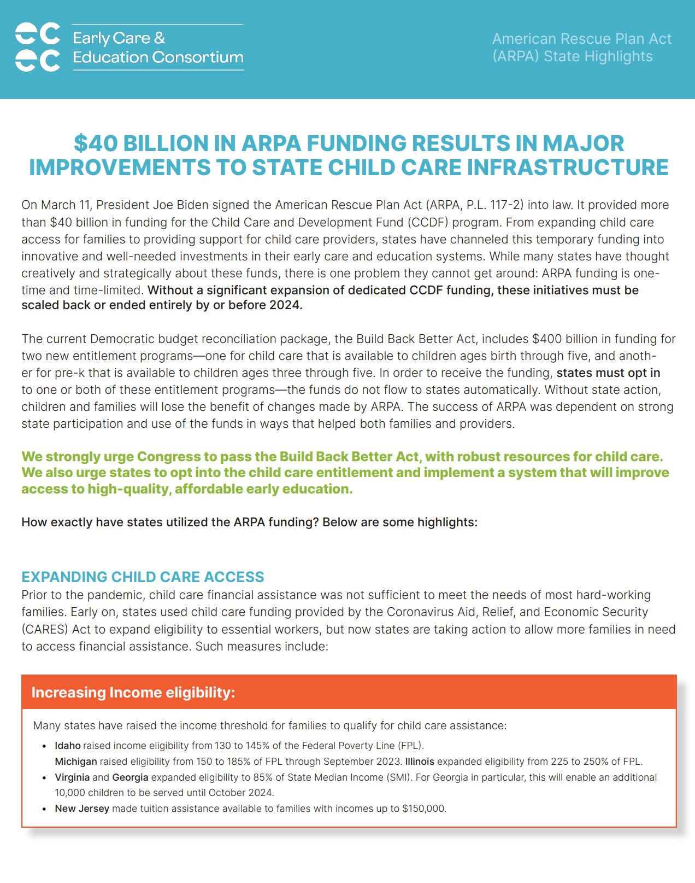
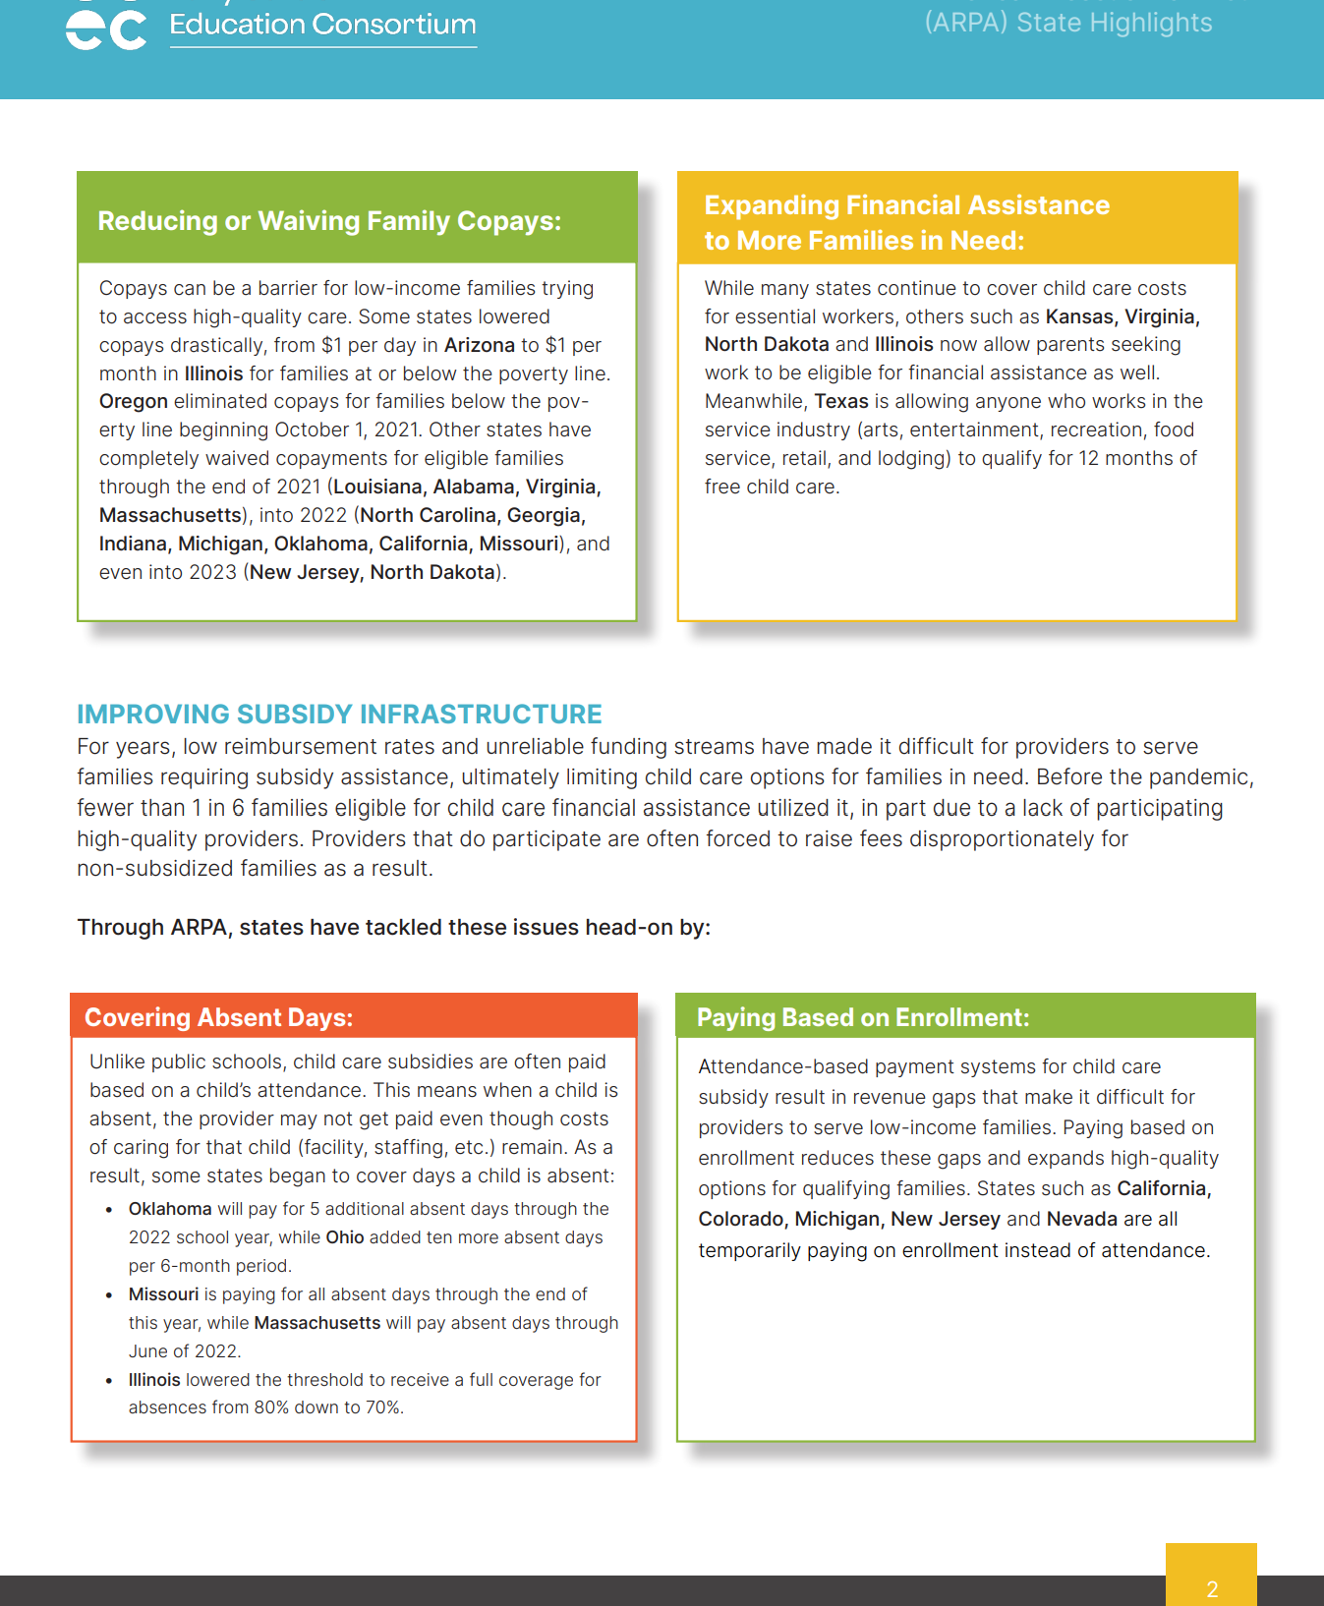
New: ARPA State Highlights

Slide 17
Q&A

