Slide 1

Howꢀtoꢀuseꢀtechnology
asꢀaꢀhelpingꢀhand
whenꢀyouꢀneedꢀitꢀmost
©ꢀ2021ꢀMarcoPoloꢀLearning,ꢀInc.

Slide 2

Whoꢀareꢀwe?
NermeenꢀDashoush,ꢀPh.D
AlexandraꢀPostꢀMiller,ꢀEd.M
ChiefꢀCurriculumꢀOfficer
DirectorꢀofꢀꢀResearchꢀ&ꢀInnovation
• M.EdꢀHarvardꢀUniversityꢀGraduateꢀSchoolꢀ
ofꢀEducationꢀandꢀMastersꢀinꢀCurriculumꢀ
andꢀTeachingꢀfromꢀColumbiaꢀUniversity.ꢀ
• 5ꢀyearsꢀteachingꢀearlyꢀchildhood.
• Formerꢀseniorꢀcontentꢀandꢀmarketingꢀ
researcherꢀatꢀScholastic,ꢀMattel/Fisherꢀ
Price,ꢀandꢀGoogle.
• PhDꢀinꢀSTEMꢀeducationꢀandꢀMastersꢀinꢀ
CurriculumꢀandꢀTeachingꢀfromꢀColumbiaꢀ
University.
• ProfessorꢀofꢀEarlyꢀChildhoodꢀEducationꢀatꢀ
WheelockꢀCollege,ꢀBostonꢀUniversity.
• Educationalꢀresearcher,ꢀ10+ꢀyearsꢀ
experienceꢀasꢀaꢀclassroomꢀteacherꢀandꢀ
curriculumꢀdeveloper.
©ꢀ2021ꢀMarcoPoloꢀLearning,ꢀInc.
2

Slide 3
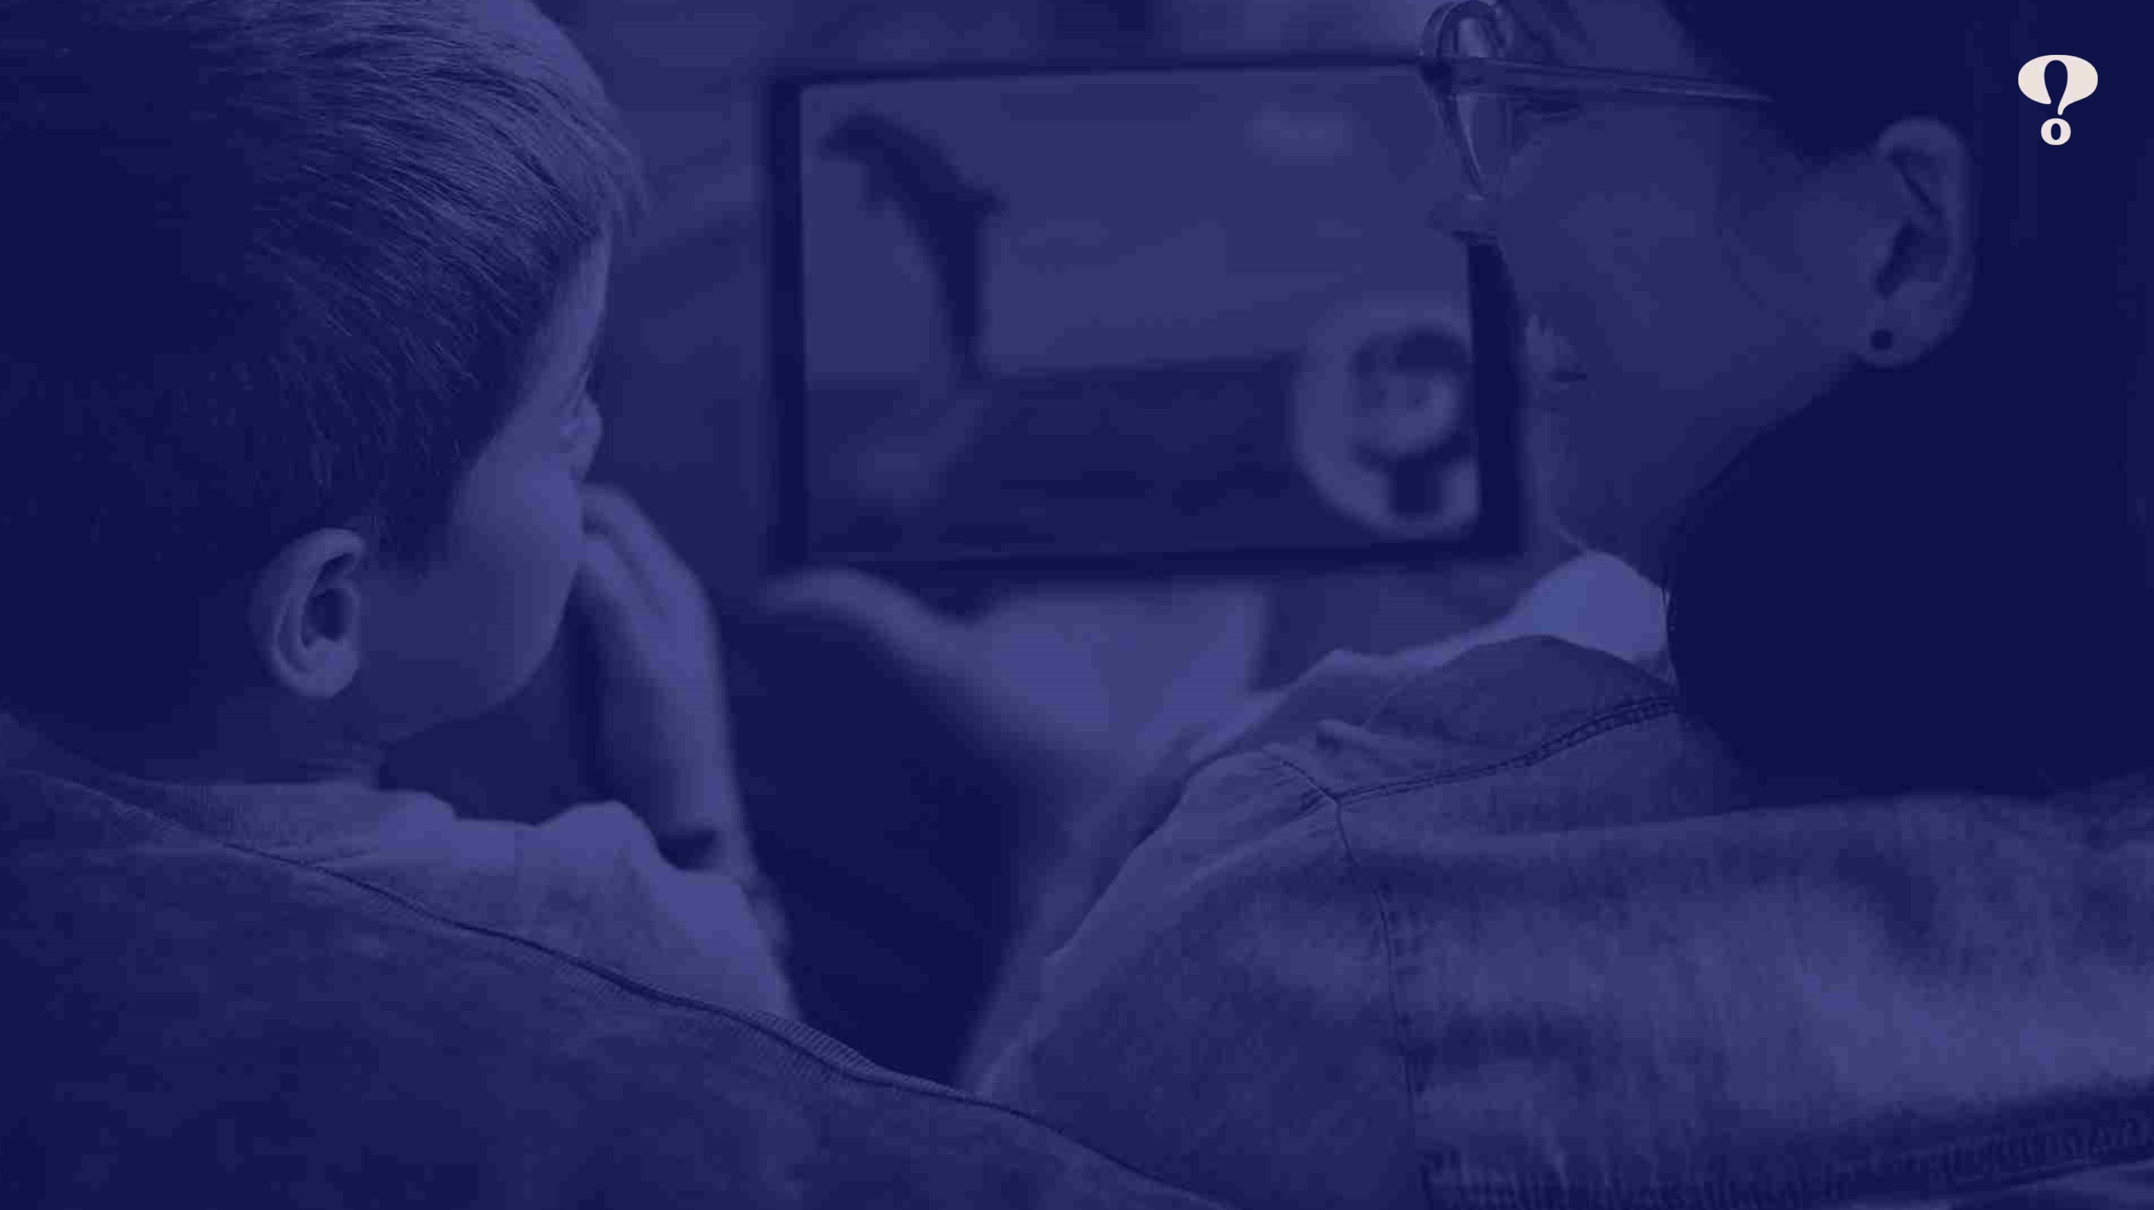
AtꢀMarcoPolo,ꢀwe’reꢀ
AlwaysꢀCurious.
MarcoPoloꢀLearningꢀisꢀanꢀaward-winningꢀeducationalꢀmediaꢀandꢀtechnologyꢀcompanyꢀꢀ
designedꢀforꢀchildrenꢀagesꢀ3-7,ꢀwithꢀanꢀemphasisꢀonꢀbuildingꢀkeyꢀskillsꢀthatꢀsupportꢀtheꢀꢀ
developmentꢀofꢀchildrenꢀpreparingꢀthemꢀforꢀsuccessꢀinꢀschoolꢀandꢀlife.ꢀMarcoPoloꢀoperatesꢀ
globallyꢀacrossꢀtheꢀlargestꢀeducationalꢀmarkets.
©ꢀ2021ꢀMarcoPoloꢀLearning,ꢀInc.
3

Slide 4
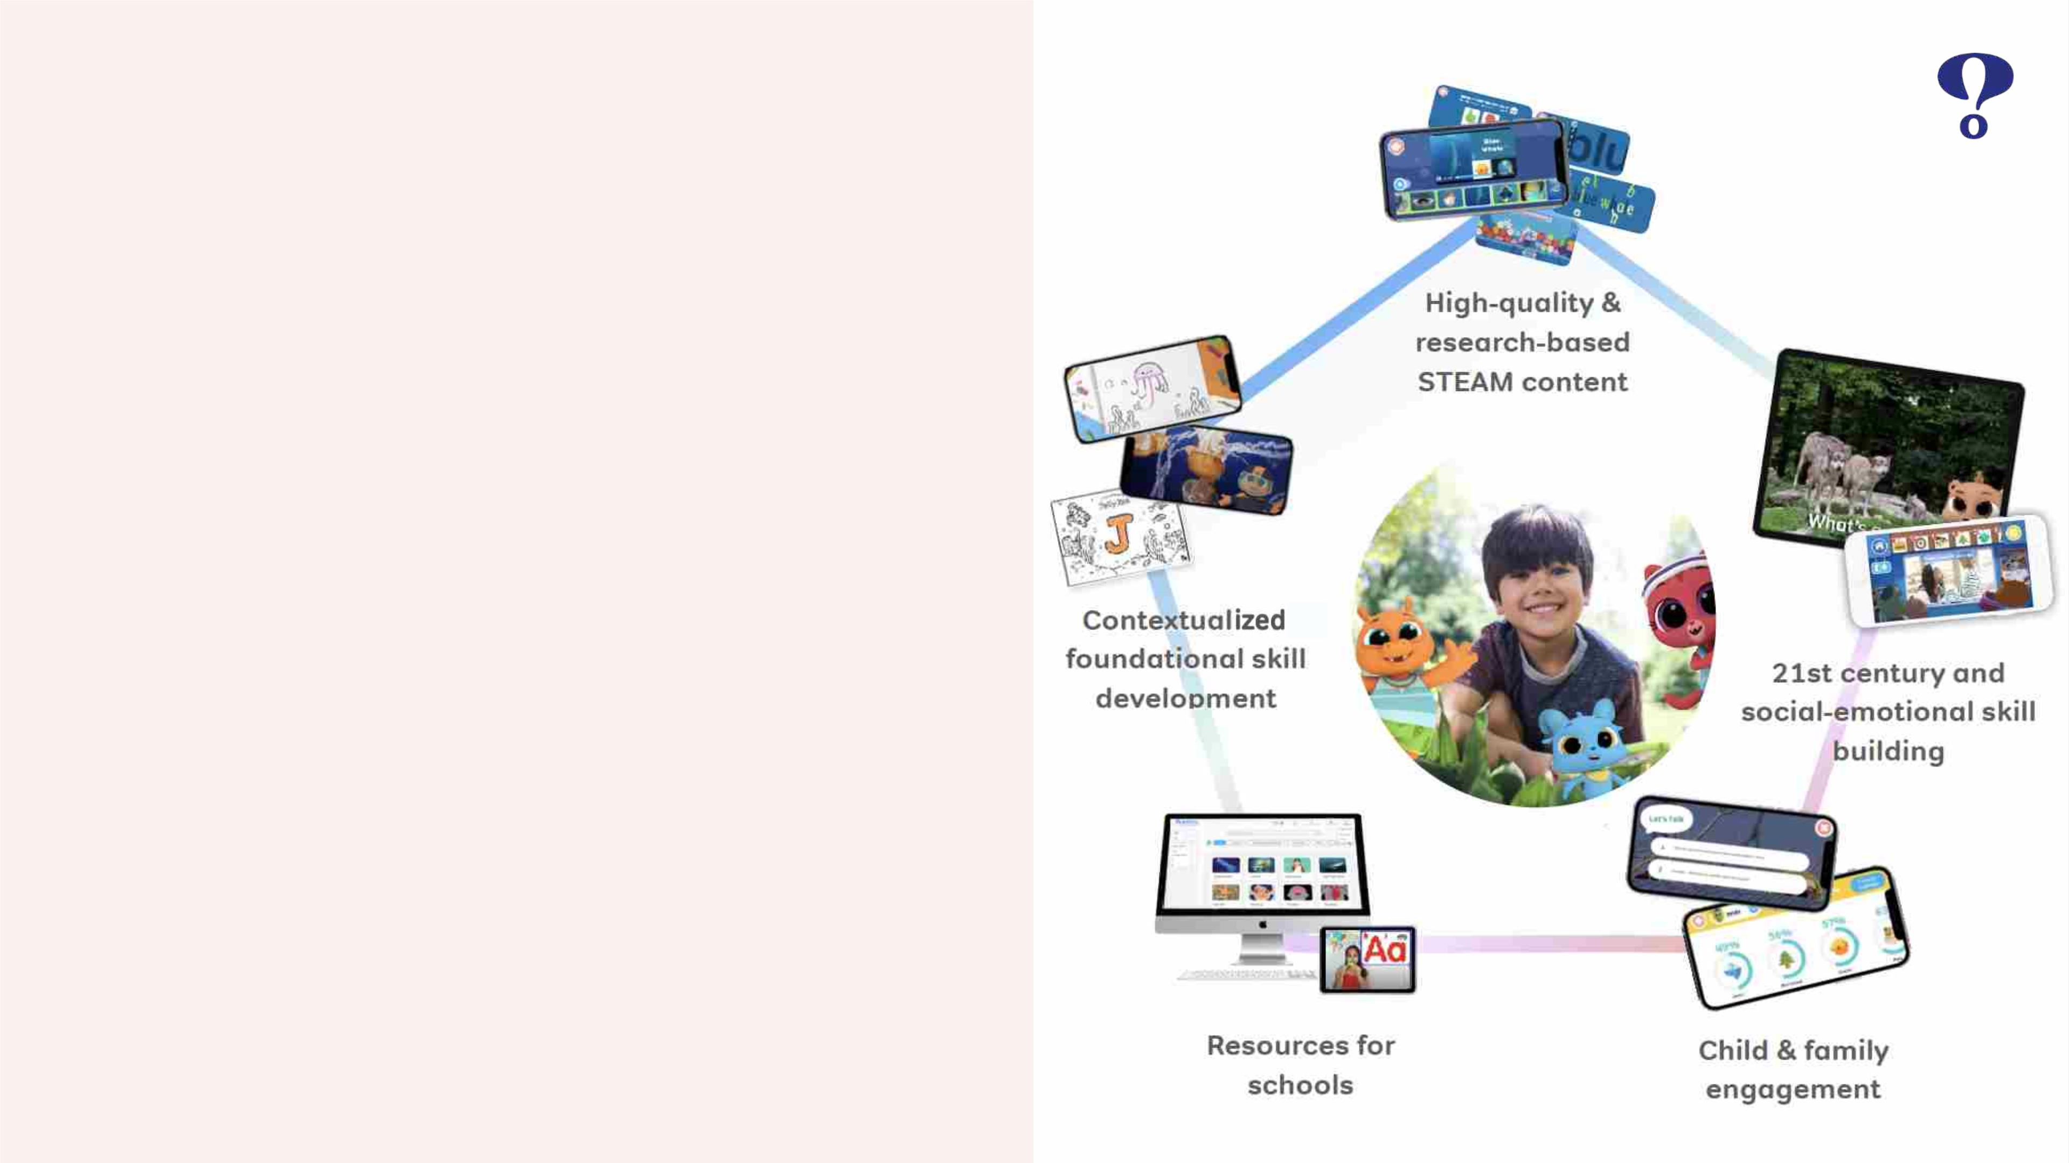
Aꢀwholeꢀchildꢀapproachꢀ
toꢀdigitalꢀlearning.
Buildꢀfoundationalꢀskillsꢀthroughꢀhighlyꢀengaging,ꢀchild-
directed,ꢀmultimediaꢀinteractionsꢀandꢀcontemporaryꢀ
game-basedꢀplay.
©ꢀ2021ꢀMarcoPoloꢀLearning,ꢀInc.

Slide 5
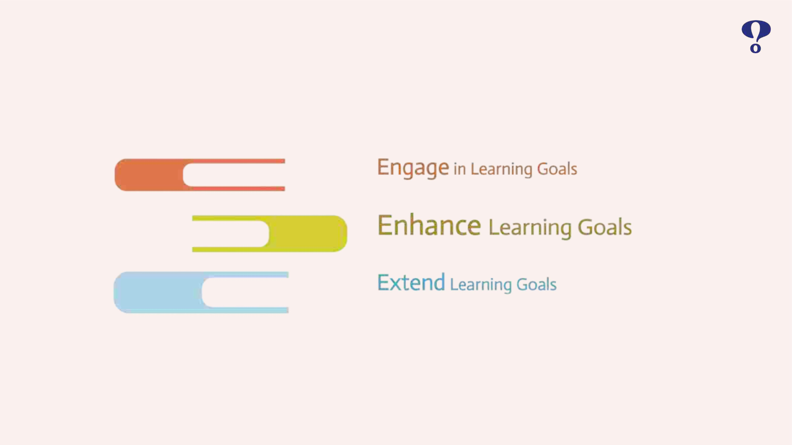
Whatꢀcanꢀ(good)ꢀtechnologyꢀdo?
Developed by Dr. Liz Kolb, Clinical Assistant Professor, University of Michigan in Ann Arbor
©ꢀ2021ꢀMarcoPoloꢀLearning,ꢀInc.
159

Slide 6
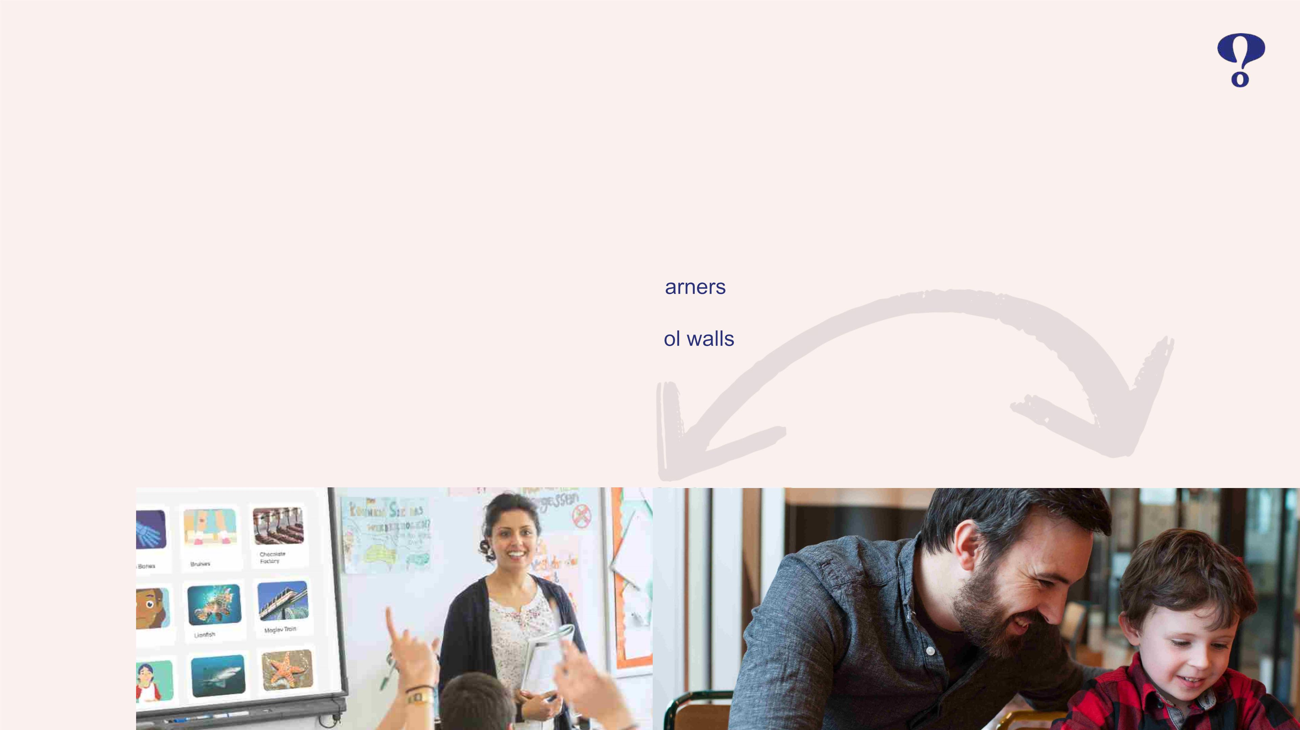
Technologyꢀcanꢀsupportꢀeducators
• Supportꢀtheꢀsocialꢀandꢀemotionalꢀdevelopmentꢀofꢀchildren
• Differentiateꢀinstructionꢀtoꢀmeetꢀtheꢀneedsꢀofꢀdiverseꢀle
• Engagedꢀwithꢀchildrenꢀandꢀfamiliesꢀoutsideꢀofꢀtheꢀscho
169

Slide 7
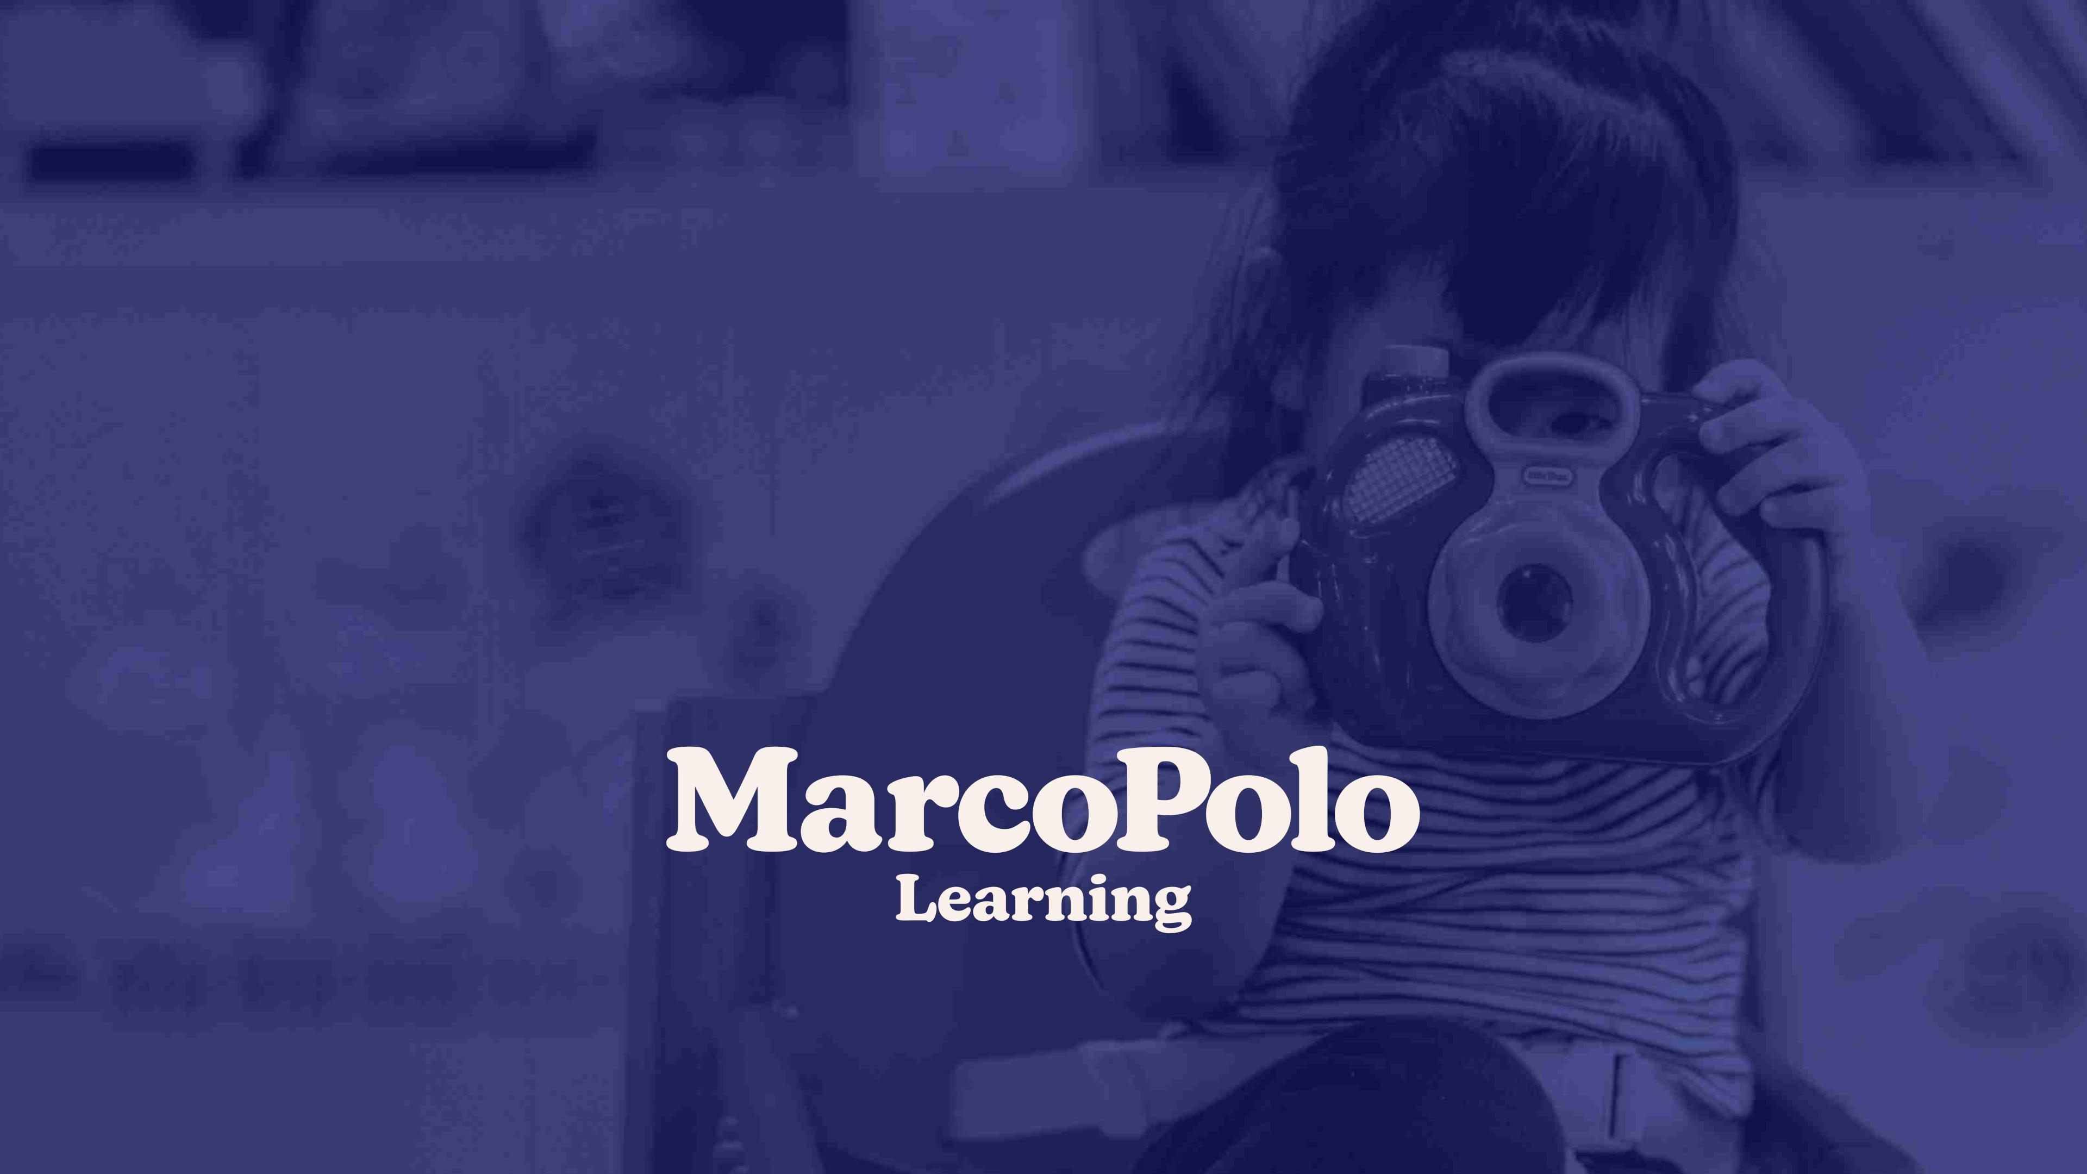
NewꢀYorkꢀ·ꢀLondonꢀ·ꢀShanghai
115ꢀBroadway
7thꢀFloor
NewꢀYork,ꢀNYꢀ10006ꢀ
USA
hello@marcopololearning.com

